Slide 1



GRIP task 2
View in Power BI
Last data refresh:
8/3/2024 7:08:00 AM UTC
Downloaded at:
8/3/2024 7:22:34 AM UTC

Slide 2
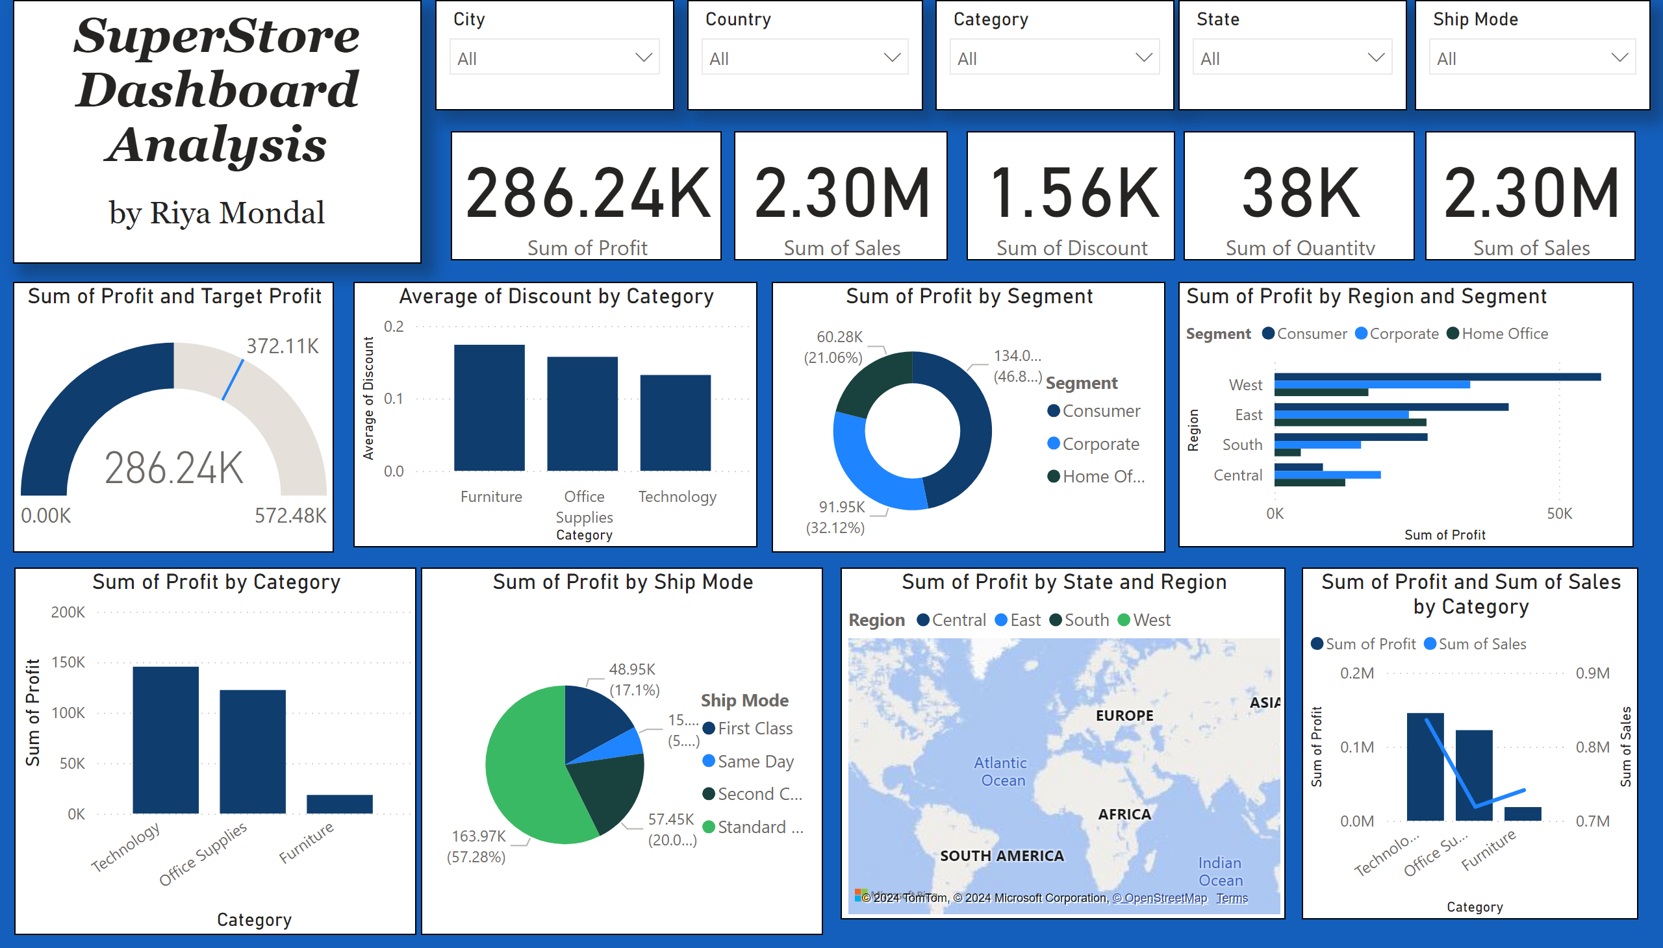
task 2
Notes:
textbox
No alt text provided
slicer
No alt text provided
slicer
No alt text provided
slicer
No alt text provided
slicer
No alt text provided
card
No alt text provided
clusteredColumnChart
No alt text provided
lineStackedColumnComboChart
No alt text provided
pieChart
No alt text provided
card
No alt text provided
card
No alt text provided
card
No alt text provided
card
No alt text provided
gauge
No alt text provided
map
No alt text provided
donutChart
No alt text provided
clusteredBarChart
No alt text provided
lineClusteredColumnComboChart
No alt text provided
slicer
No alt text provided

